Slide 1



Delft-FEWS
Basic Configuration Course

Slide 2
Basic Configuration Course
Content
Overview and basic configuration
Tools
Exercises
Working with data – imports, validation, thresholds
Displays and workflows
Interpolation and transformation
Introduction to the general adapter

Slide 3
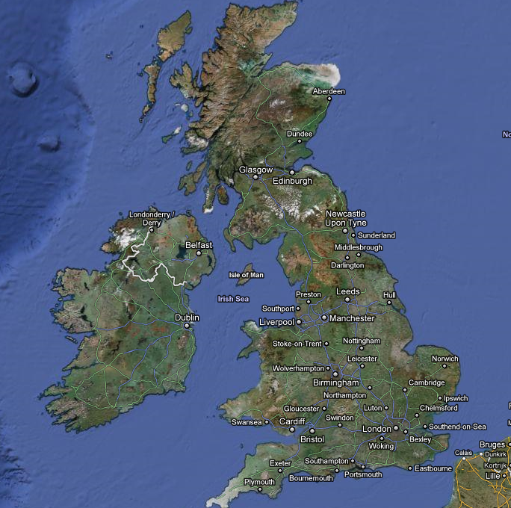
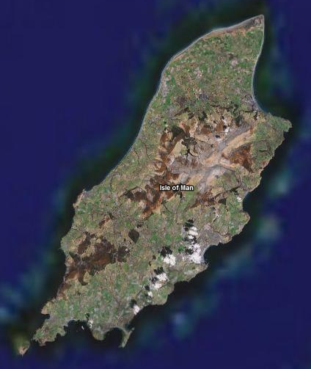
Introduction to the course
The course exercises will be based around the Isle of Man (IoM) – a small island between England and Ireland
We will:
add locations
import, analyse and process data
run unit hydrograph model
display data
stand alone

Slide 4


Configuration and XML files

Slide 5
Firstly – what is XML anyway?
All FEWS configuration files are written in XML format
XML stands for EXtensible Markup Language – written in simple plain text
XML tags are predefined by FEWS.
Example:
<note>
<to>Martin</to>
<from>Alex</from>
<heading>Reminder</heading>
<body>Don't forget support this weekend!</body>
</note>
FEWS interprets the XML files using an XSD
<location id="1009" name="Pen Y Coed">
<description>Meteorological Gauge</description>
<shortName>Pen-Y-Coed</shortName>
<x>297800</x>
<y>314400</y>
<z>305.00</z>
</location>
<ComplexType first_attribute=“id” second_attribute=“name”>
<Element> value </Element>
<Element> value </Element>
</ComplexType >

Slide 6
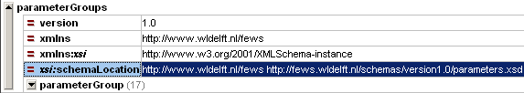
What is an XSD?
XML Schema Definition
An XML Schema defines the building blocks of an XML document
States what can be included and in what order
XML is valid when organised according (open) schema XSD Every time you open FEWS it checks all configuration files are valid
Also simple text files
Can be found in a zipped file in the ‘bin’ directory (Delft_FEWS_schemas.jar)

Slide 7
XML Configuration and XSD Schemas
Each XML configuration adheres to a XSD schema
Two types of configuration items
Singular configuration – e.g. Locations
Multiple configurations – e.g. Import Modules
XML
Config
XSD
Definition
Names of files are fixed
XML
Config
XSD
Definition
Names of files are free
XML
Descriptor
i.e. module instance descriptors file
Notes:
What is an xml file?

Slide 8
Naming Conventions & Version management
File naming convention – Singular configuration Locations 1.00 default.xml
Locations Fixed filename
1.00 Version number
default Flag indicating “active” configuration
optional
Don’t use this when you use a version system like subversion

Slide 9
Naming Conventions & Version management
File naming convention – Multiple configuration ImportRTS 1.00 default.xml
ImportRTS Filename for this instance of the ImportModule
1.00 Version number
default Flag indicating “active” configuration
Each file must be “registered” in a descriptor file
Allowes for “readable” name
Identifies what configuration is

Slide 10
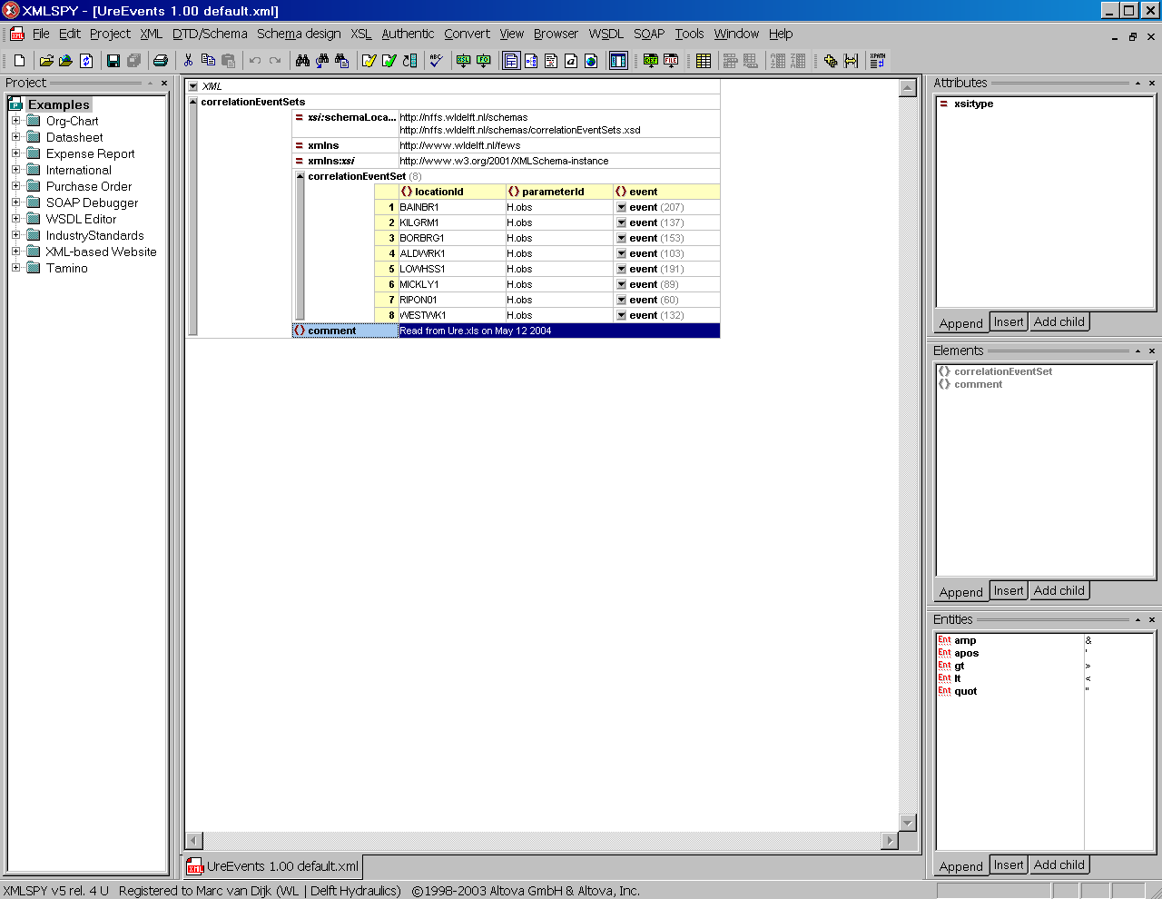
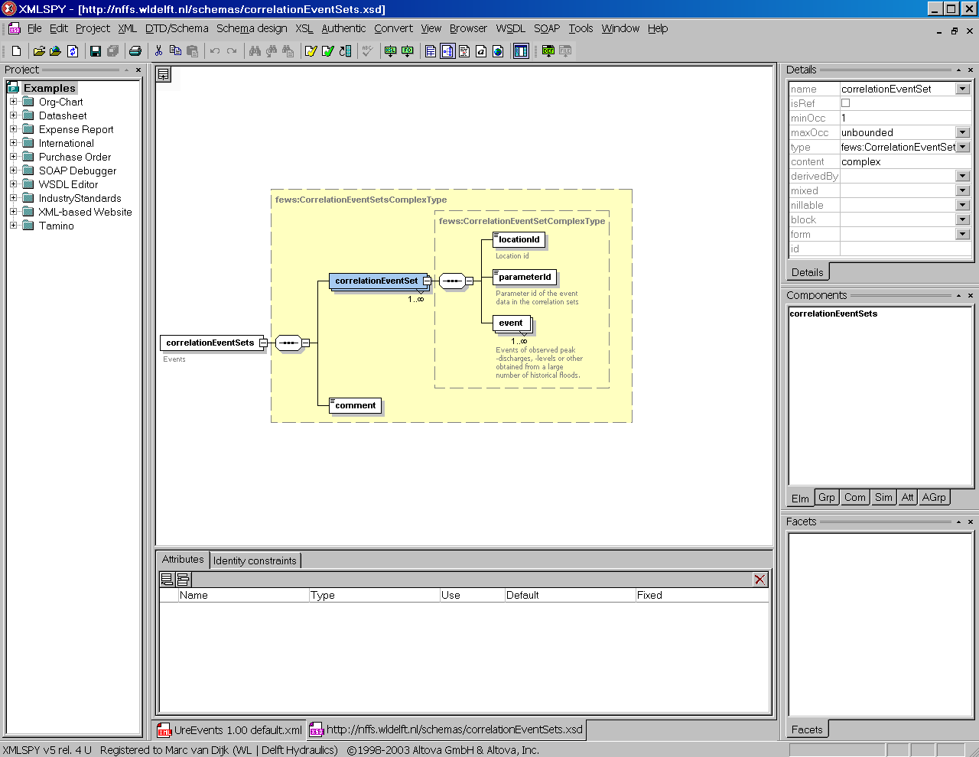
Tools – XML-Spy or oXygen
Create, edit and validate XML files
Create and view XSD schema’s

Slide 11
Exercise
Exercise 1: XML-Spy

